Slide 1
Antidote benchmark using YCSB

Slide 2
Outline
1. Docker connecting to Antidote client
2. Antidote client wrapper
3. Running benchmark using YCSB
4. Realization of the results

Slide 3
Docker connecting to Antidote client

Slide 4
Antidote client wrapper
Antidote client wrapper is used to connect to the database(with the help of docker) and DB interface layer in YCSB.
Since the YCSB operation is different from the antidote datatypes. It helps to bridge between the Antidote datatypes and basic operations available in YCSB and provide necessary input to perform the operation in the YCSB.

Slide 5
Running benchmark using YCSB
What is YCSB?
YCSB – Yahoo! Cloud Serving Benchmark
YCSB is a framework for bench-marking systems. The primary goal of YCSB is to develop framework and common set of workloads to evaluate the different ‘Key – value’ and ‘Could’ serving stores.
YCSB mainly benchmarks the throughput and latency of the database operation.
We have to create the DB interface layer to add any new database. This interface layer will have few operations(Insert, delete, update,scan) available in YCSB.

Slide 6
Contiuned..
YCSB helps to benchmark the database using workloads. There are six different core workload available in YCSB. Also we can create customized workload to run benchmark. Below are the few workload properties:
readproportion, updateproportion,maxscanlength,exportfile,etc.,

Slide 7
Realization of the results

Slide 8
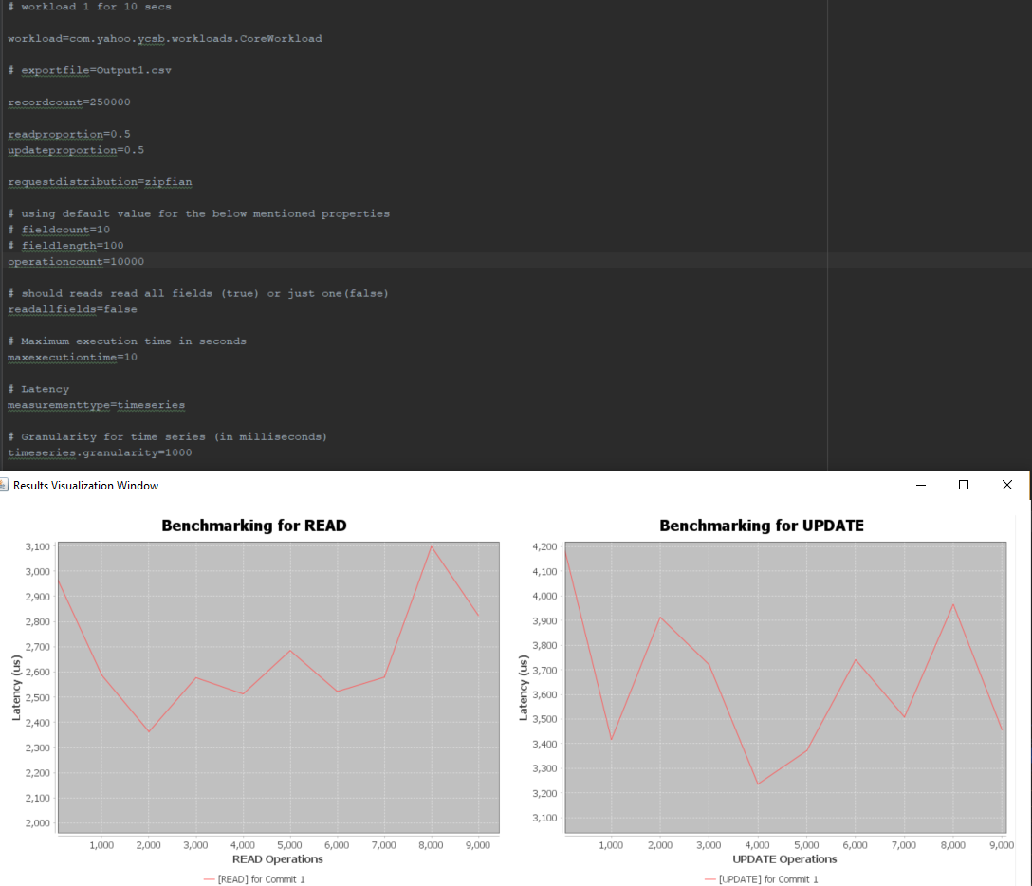
Sample results

